Slide 1
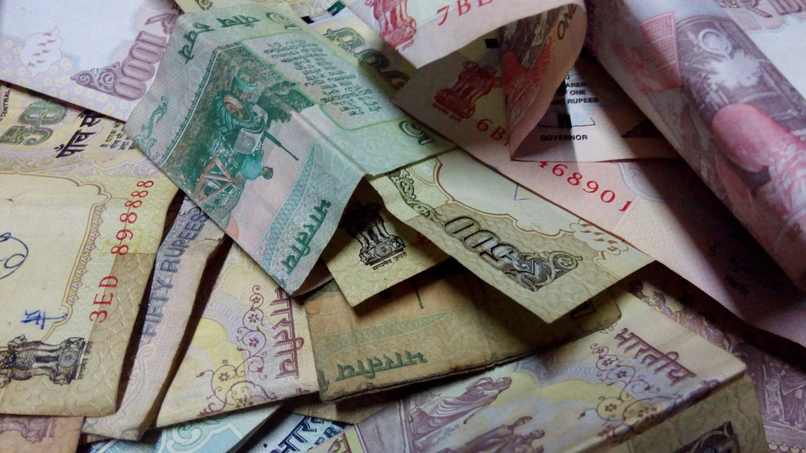
“ Money Can’t Buy Happiness “

Slide 2
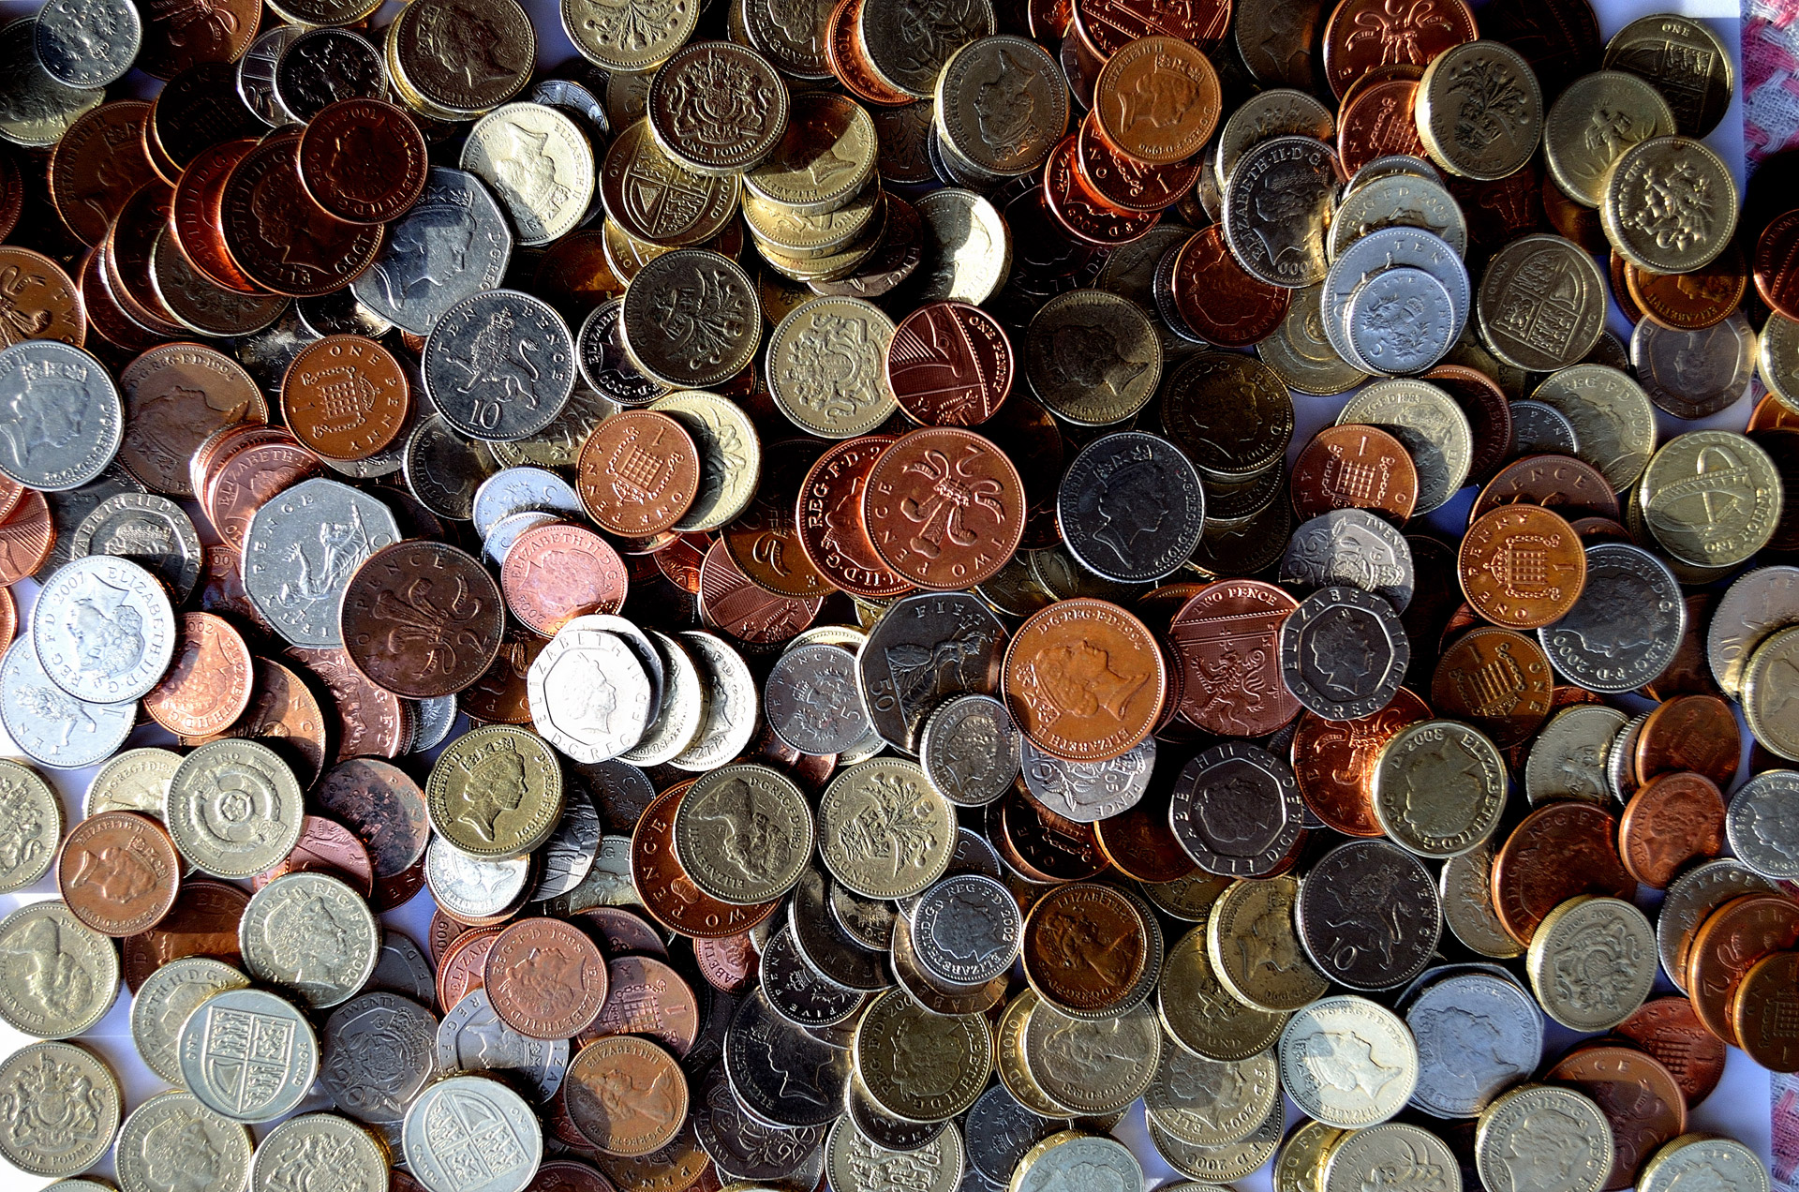
What are your thoughts on money?

Slide 3
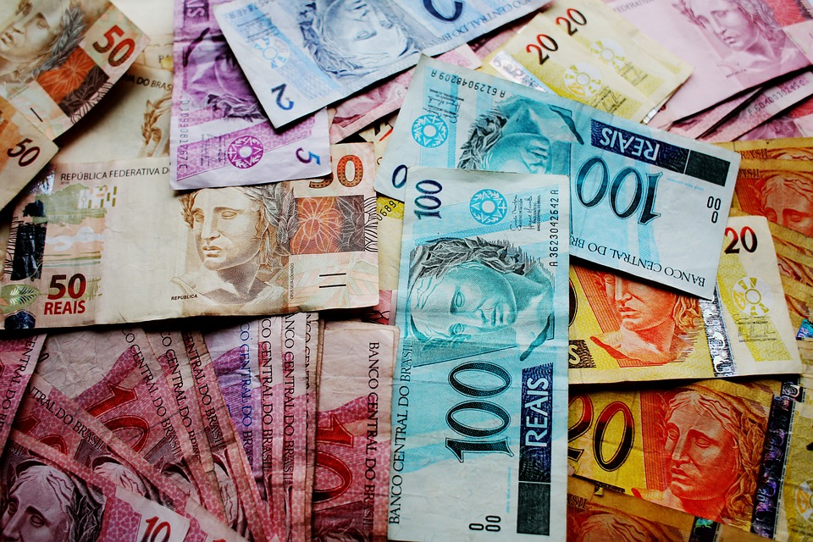
Four Reasons Why Money Can’t Buy Happiness.
People will never be satisfied.
Money can't buy time.
Money Can't Buy True Friends.
Happiness is Doing What You Love.

Slide 4
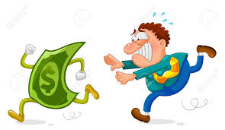
People will never be satisfied.
.
Social comparison
The desire for more

Slide 5
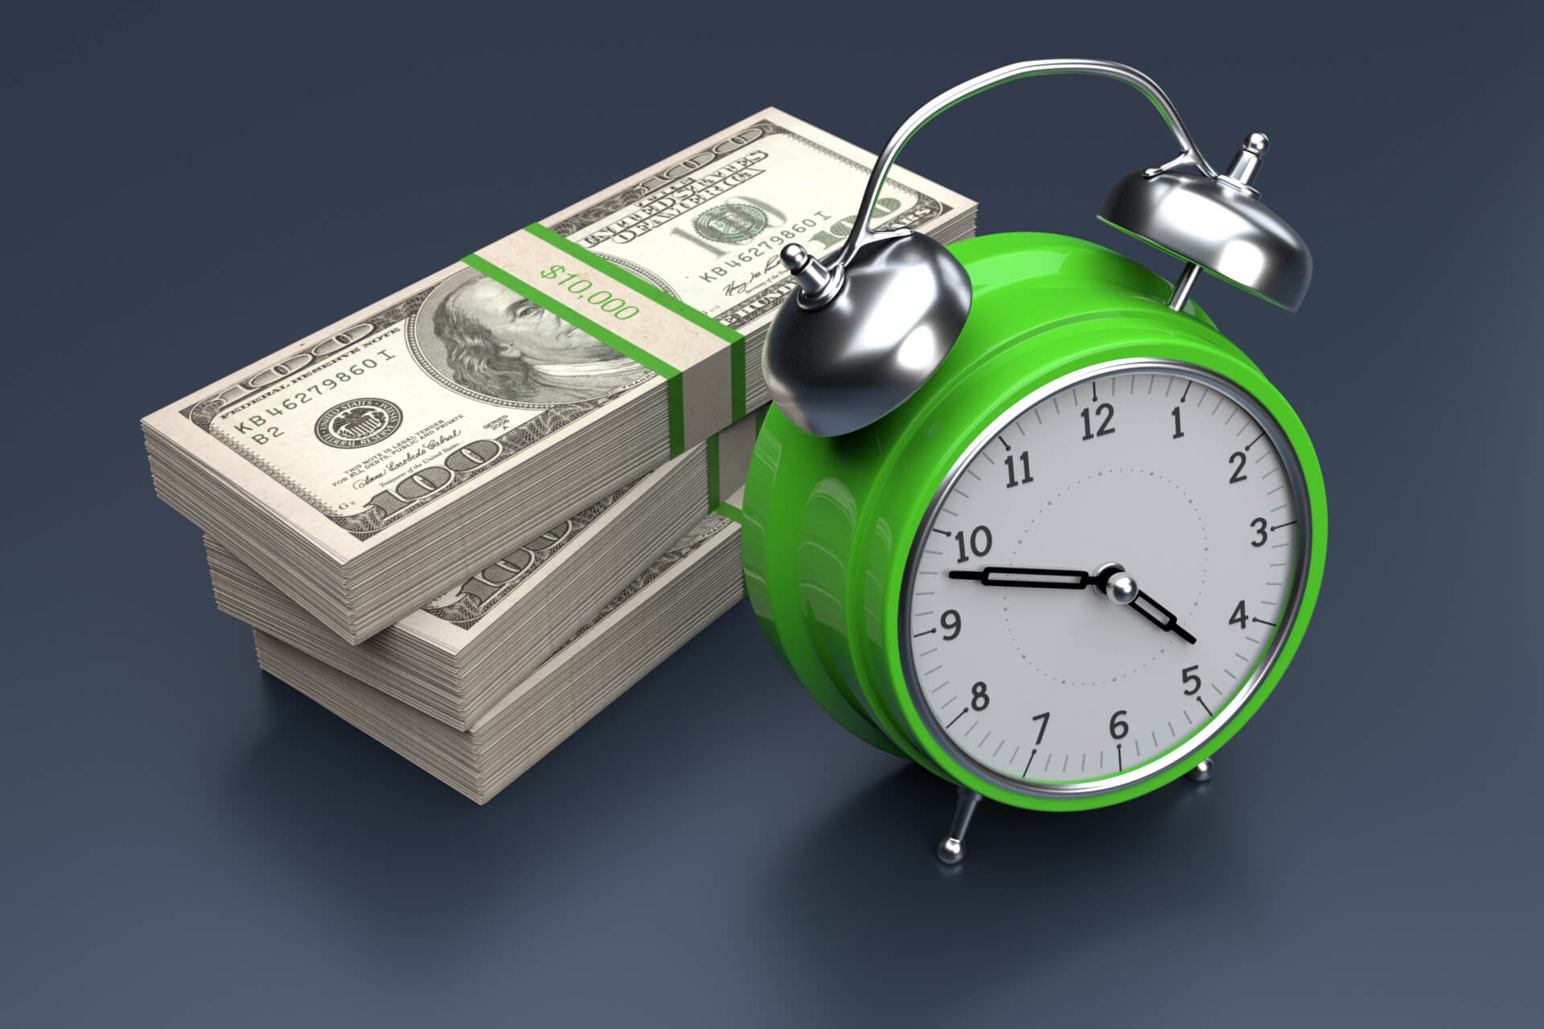
Money can't buy time.
Limited resource
Unpredictability

Slide 6
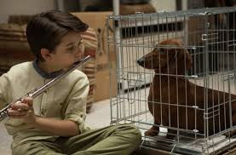
Money Can't Buy True Friends.
Trust and loyalty
Emotional support

Slide 7

Happiness is Doing What You Love.
Happiness comes from doing the things you love, not from your bank account.

Slide 8
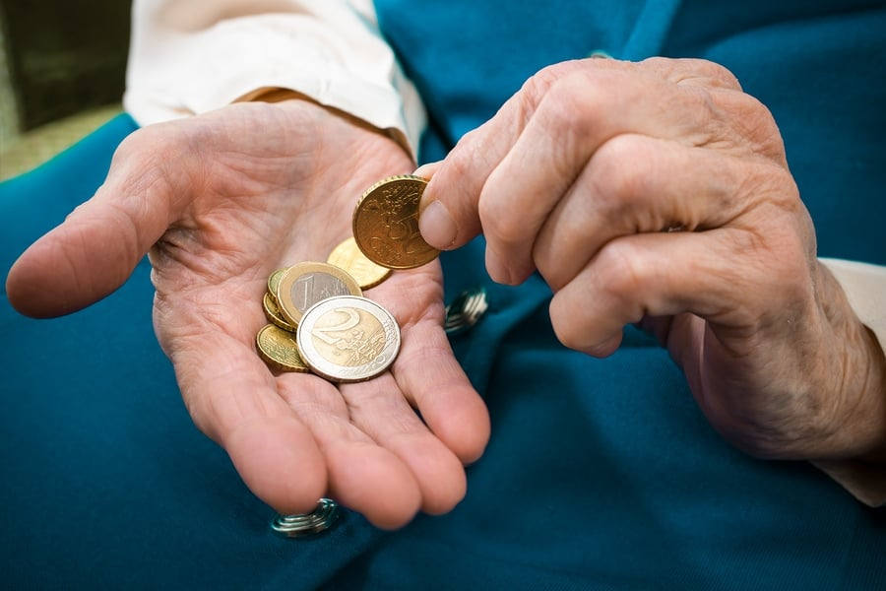
THANK
YOU

